Slide 1
Type Checking and Data Type Implementation
(Sections 7.2- 7.4)
CSCI 431 Programming Languages
Fall 2003
A compilation of material developed by Felix Hernandez-Campos and Michael Scott

Slide 2
Type Checking
Type equivalence
  When are the types of two values the same?
Type compatibility
  When can a value of type A be used in a context that expects type B?
Type inference
  What is the type of an expression, given the types of the operands?

Slide 3
Type Checking
Type equivalence
  When are the types of two values the same?
Type compatibility
  When can a value of type A be used in a context that expects type B?
Type inference
  What is the type of an expression, given the types of the operands?

Slide 4
Type Equivalence
Type equivalence is defined in two principal ways
  Structural equivalence
  Name equivalence
Two types are structurally equivalent if they have identical type structures
  They must have the same components
  E.g. Fortran
Two type are nominally equivalent if they have the same name
  It may or may not include alias
  E.g. Java
  Name equivalence is more fashionable these days

Slide 5
Type Equivalence
Structural Equivalence
Structural equivalence depends on simple comparison of type descriptions substitute out all names; expand all the way to built-in types. Original types are equivalent if the expanded type descriptions are the same
Pointers complicate matters, but the Algol folks figured out how to handle it in the late 1960's. The simple (not quite correct) approach is to pretend all pointers are equivalent.

Slide 6
Type Equivalence
Structural Equivalence
Does the format of the declaration depend?
typedef struct { int a, b; } foo1;
typedef struct {
int a, b;
} foo2;
All languages consider these two types structurally equivalent

Slide 7
Type Equivalence
Structural Equivalence
Is the order in the declaration relevant?
typedef struct {
int a;
int b;
} foo1;
typedef struct {
int b;
int a;
} foo2;
Most languages consider these two types structurally equivalent

Slide 8
Type Equivalence
Structural Equivalence Pitfall
Are these two types structurally equivalent?
typedef struct {
char *name; char *address; int age;
} student;
typedef struct {
char *name; char *address; int age;
} school;
They are, and it is unlikely that the programmer intended to make these two types equivalent

Slide 9
Type Equivalence
Name Equivalence
Assumes type definitions with different names are not equivalent
  Otherwise, why did the programmer create two definitions?
It solves the previous problem
  student and school are not nominally equivalent
Aliases:
  Under strict name equivalence, aliases are not equivalent
    type A = B is a definition (i.e. new object)
  Under loose name equivalence, aliases are equivalent
    type A = B is a declaration (i.e. binding)

Slide 10
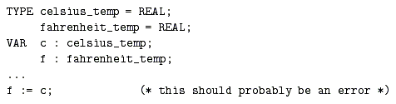
Type Equivalence
Name Equivalence and Aliases
Loose name equivalence may introduce undesired type equivalences

Slide 11
An Example
Strict name equivalence:
  types are equivalent if they refer to the same declaration
Loose name equivalence
  types are equivalent if they refer to the same outermost constructor,
  i.e. if they refer to the same declaration after factoring out any type aliases.
Example:
  type alink = pointer to cell;
  subtype blink = alink;
  p, q : pointer to cell;
  r : alink;
  s : blink;
  u : alink;

Slide 12
An Example
Structural equivalence says all five variables have same type.
Strict name equivalence equates types of p & q and r & u, because they refer back to the same type declaration (a constructor on the RHS of a var declaration is an implicit declaration of an ANONYMOUS type)
Loose name equivalence equates types of p & q and r, s, & u because in both cases we can trace back to the same "^" constructor.

Slide 13
Type Conversion
A values of one type can be used in a context that expects another type using type conversion or type cast
Two flavors:
  Converting type cast: underlying bits are changed
    E.g. In C,
    int i; float f = 3.4;
    i = int(f);
  Nonconverting type cast: underlying bits are not altered
    E.g. In C,
    int i; float f; int j = 4;
    i = j;
    i = *((int *) &f);
Notes:
Run-time conversion

Slide 14
Type Checking
Type equivalence
  When are the types of two values the same?
Type compatibility
  When can a value of type A be used in a context that expects type B?
Type inference
  What is the type of an expression, given the types of the operands?

Slide 15
Type Compatibility
Most languages do not require type equivalence in every context
Two types T and S are compatible in Ada if any of the following conditions is true:
  T and S are equivalent
  T is a subtype of S
  S is a subtype of T
  T and S are arrays with the same number of elements and the same type of elements

Slide 16
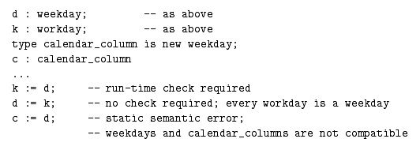
Type Compatibility
Implicit type conversion due to type compatibility are known as type coercions
  They may involved low-level conversions
Example:
type weekday is (sun,mon,tue,wed,thur,fri,sat);
  subtype workday is weekday range mon..fri;

Slide 17
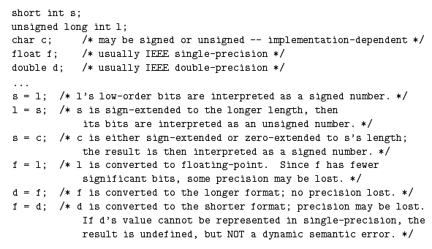
Type Compatibility
Type coercions make type systems weaker
Example:

Slide 18
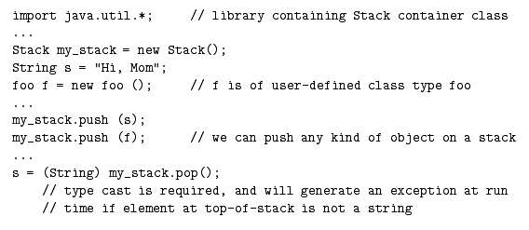
Type Compatibility
Generic container objects require a generic reference type
Example

Slide 19
Type Checking
Type equivalence
  When are the types of two values the same?
Type compatibility
  When can a value of type A be used in a context that expects type B?
Type inference
  What is the type of an expression, given the types of the operands?
  Generally easy, but subranges and composites may complicate this issue

Slide 20
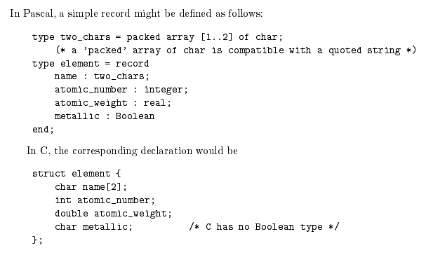
Records

Slide 21
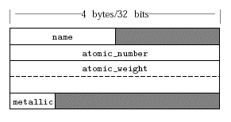
Records
Memory Layout
Basic layout in 32-bit machines
  There may be holes in the allocation of memory

Slide 22
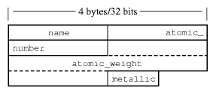
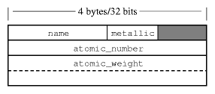
Records
Memory Layout
Packed layout
Rearranging record field

Slide 23
Records
Implications of Memory Layout
More memory efficient layouts have several drawbacks
  Assignments require multiple instructions
    Masking and shifting operations
  Access to record elements requires multiple instructions
    Masking and shifting operations
Holes complicate record equality
  Requires field by field comparison or default values in holes
  Some languages forbid record comparison
    E.g. Pascal, C

Slide 24
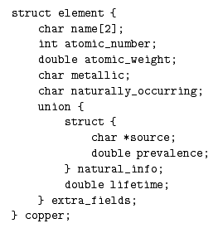
Variant Records
A variant record provides two or more alternative fields or collections of fields, but only one of the alternatives is valid at any given time
  They are called unions in C/C++

Slide 25
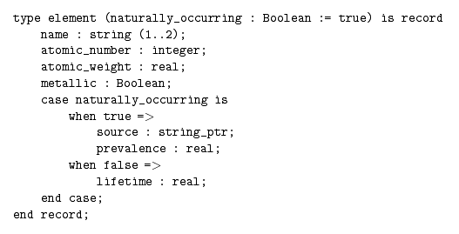
Safe Unions (Ada)

Slide 26
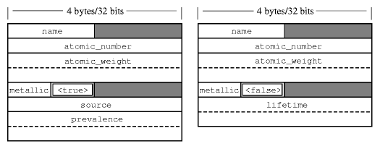
Variant Records
Memory Layout
Some languages, like C, do not check whether variant records are properly access
Other languages keep track of the value in an additional field, increasing safety

Slide 27
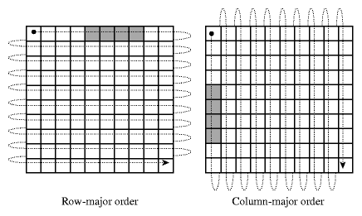
Arrays
Memory Layout
Arrays are usually stored in contiguous locations
Two common orders

Slide 28
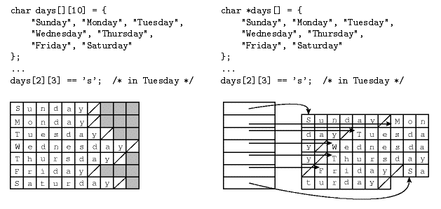
Arrays
Memory Layout
Contiguous allocation vs. row pointers

Slide 29
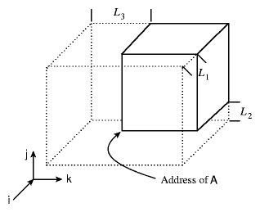
Arrays
Address Calculations
Code generation for a 3D array
  A: array [L₁..U₁] of array [L₂..U₂] of array [L₃..U₃] of elem_type

Slide 30
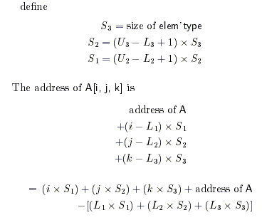
Arrays
Address Calculations
Row-Major
Order
Optimization
Compile-Time
Constant

Slide 31
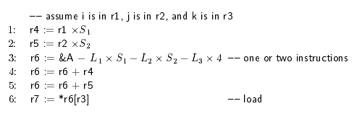
Arrays
Address Calculations
Instruction sequence to load A[I,j,k] into a register:

Slide 32
Dope Vectors
Descriptors (dope vectors) are required when array bounds are not known at compile time.
A dope vector is usually stored next to the pointer to data.
Typically, a dope vector for an array of dynamic scope will contain the lower bound for each dimension and the size of every dimension.
Upper bounds are also need to support dynamics out-of-bounds checking
When bounds are know the arithmetic can be done at compile time

Slide 33
Arrays: Lifetime and Shape
Lifetime (how long object exists) and shape (dimensions and bounds), common options:
  global lifetime, static shape
    Pascal, C globals
  local lifetime, static shape
    Pascal, C locals
  local lifetime, shape bound at elaboration
    Ada locals
  arbitrary lifetime, shape bound at elaboration
    Java arrays
  arbitrary lifetime, dynamic shape
    Icon strings, APL, Perl arrays

Slide 34
Dope Vectors
The first two classes are just familiar global and local variables.
The third class can still be put in a procedure's activation record;
  you put the dope vector and a pointer at a fixed offset from the FP and the data itself higher up in the frame.
The fourth and fifth have to be allocated off a heap.

